Slide 1
Quiz

Slide 2
Classroom Quiz: Melt
Q1. What does melt() usually do?
A. Converts long data into wide data
B. Converts wide data into long data
C. Deletes duplicate rows
D. Sorts the DataFrame
Answer: B. It converts wide data into long data.
Notes:
Answer: B — It converts wide data into long data.

Slide 3
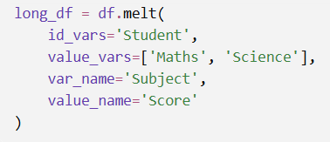
Classroom Quiz: Melt
Q2. Find the Identifier
Consider:
What happens to the Student column?
Answer: C — Student remains an identifier column.
A. It is deleted
B. It becomes the DataFrame index
C. It remains an identifier, and its values may be repeated
D. It is renamed Score
Notes:
Answer: C — Student remains an identifier column.

Slide 4
Classroom Quiz: Melt
Q3. Count the Columns
A DataFrame has two identifier columns; four columns to melt.
How many columns will the melted DataFrame normally have?
A. 2
B. 4
C. 6
D. 8
Answer: B — 4 columns.
The output contains:
2 identifier columns + 1 variable column + 1 value column
Notes:
Answer: B — 4 columns.
The output contains:
2 identifier columns + 1 variable column + 1 value column

Slide 5
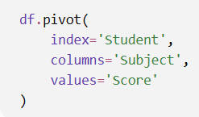
PivoT
Q4. Build the Wide Table
Consider:
What becomes the new column headers?
A. Student names
B. Score values
C. Unique values from Subject
D. The original row numbers
Answer: C — Subject values such as Maths and Science become column headers.
Notes:
Answer: C — Subject values such as Maths and Science become column headers.

Slide 6
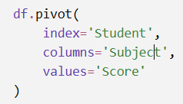
Duplicate Trouble!
Q5.The data contains:
What happens with this code?
Student | Subject | Score
Ali | Maths | 80
Ali | Maths | 90
A. It automatically calculates the mean
B. It keeps the first score
C. It produces an error
D. It adds the scores
Answer: C — pivot() cannot handle duplicate index–column combinations.
It cannot decide whether the Ali–Maths cell should contain 80 or 90.
Notes:
Answer: C — pivot() cannot handle duplicate index–column combinations.
It cannot decide whether the Ali–Maths cell should contain 80 or 90.

Slide 7
Choose Your Tool
Q6. Which choice is correct?
A. Use melt() for long-to-wide
B. Use pivot() when duplicate combinations must be averaged
C. Use pivot_table() when duplicates may need aggregation
D. Use pivot_table() only for text columns
Answer: C — pivot_table() is suitable when duplicate combinations must be summarised.

Slide 8
Take away
melt() makes data longer,
pivot() makes unique data wider, and
pivot_table() makes data wider while also summarising duplicates.

Slide 9

rank
What does the following code do?
A. Gives the smallest fire rank 1
B. Gives the largest fire rank 1
C. Sorts the DataFrame from largest to smallest
D. Removes duplicate fire sizes
Answer: B — Gives the largest fire rank 1
Notes:
Answer: B — Gives the largest fire rank 1

Slide 10

nlargest
What does this code return?
A. Five randomly selected fires
B. Five fires with the smallest burned areas
C. Five fires with the largest burned areas
D. All fires with rank 5
Answer: C — Five fires with the largest burned areas

Slide 11

Cut and qcut
What is the main difference between these functions?
A. cut() works with numbers, but qcut() works only with text
B. cut() creates four equal-width ranges, while qcut() creates groups with approximately equal numbers of observations
C. cut() sorts the data, while qcut() ranks it
D. There is no difference
Answer: B

